Slide 1

Slip, Trip and Fall Prevention
Sumith Wijeweera, M.S.
Julia Lerch, Intern
Risk Management Services

Slide 2
Objectives
Common causes of slips, trips and falls
Measures to take to minimize the potential for slips, trips and falls
Liability
Use of a slip meter to define a slippery/non slippery floor

Slide 3
Contributing factors
Environment
Social
Physiology
Physiology - balance, hearing, vision
Social – medications, age,
health,
Environmental – flooring
type, maintenance, lighting,
hazards-oil or wet surfaces

Slide 4
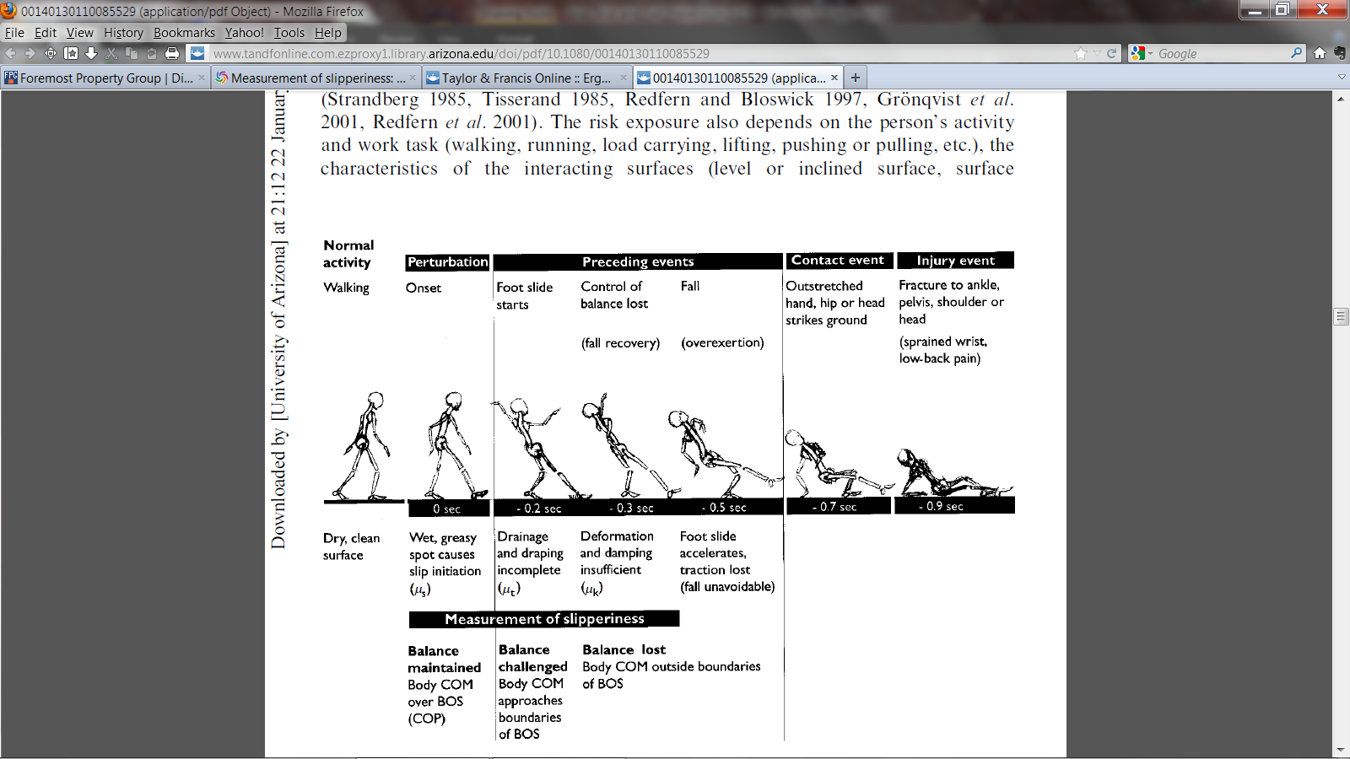
Center of Gravity
COM-Center of body mass
BOS-Base of support
COP-Center of foot pressure
Gronqvist, 2001

Slide 5
Three Forces
Friction- walking surface and soles of the shoe
Momentum- involves speed and size
Gravity- without support, gravity causes
objects to fall towards the earth

Slide 6
Slipping
‘a sudden loss of grip, often in the presence of liquid or solid contaminants and resulting in sliding of the foot on a surface due to a lower coefficient of friction than that required for the momentary activity’
Common causes:
-loose mats,
-flooring surface that is worn,
-wet or oily surfaces,
-weather hazards,
-occasional spills,
-insufficient lighting
-aging
Gronqvist, 2001

Slide 7
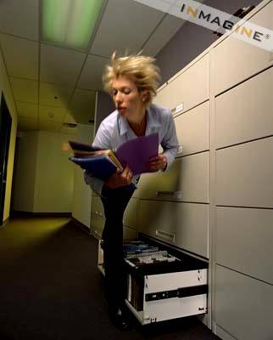
Trips
-hit an object, lose your balance and fall
Common Causes:
-Obstructed view
-Poor lighting
-Clutter in your way
-Wrinkled carpet
-Uncovered cables
-Drawers left open
-Uneven walking surfaces

Slide 8
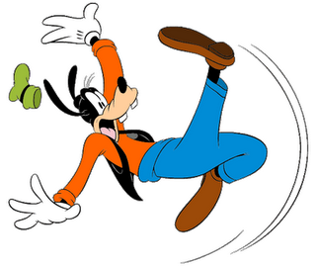
Falls
-when you lose your balance and descend to the floor
Three types of falls
-same level fall
-lower level fall
-jumps to lower level

Slide 9
Prevention
Good Housekeeping
Quality of walking surfaces (flooring)
Selection of proper footwear
Appropriate pace of work

Slide 10

Liability
Proper floor maintenance
Measurement of slipperiness
Limit your risk exposure

Slide 11
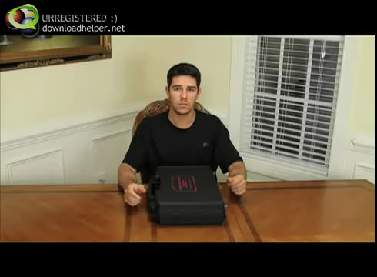
Slip Meter

Slide 12
American Society of Testing and Materials (ASTM)
Use a slip meter to determine if the floor is safe.
A slippery floor has a reading of below 0.50 Coefficient of Friction (COF).
A non-slippery floor is 0.50 COF or above.
ASTM D 2047 and the Slip and Fall Handbook

Slide 13
Coefficient of Friction (COF):
-the value between 0 and 1. It describes the degree of interaction between two surfaces.
A higher COF indicates two surfaces in contact have a greater resistance.
A lower COF indicates the two surfaces in contact have less resistance.
ex. Soccer cleats on grass have a greater coefficient of friction than skates on ice.
Wiki.answers.com

Slide 14
Report Hazards Immediately
If you cannot fix the hazard yourself then:
Immediately report the hazard to your supervisor
Alert or warn others in the area
  Mark the area or stay there until help arrives

Slide 15
Questions?

Slide 16
Citations
Grönqvist, R., Chang, W.-R., Courtney, T., Leamon, T., Redfern, M., & Strandberg, L. (October 20, 2001). Measurement of slipperiness: fundamental concepts and definitions. Ergonomics, 44, 13, 1102-1117.
Rosen, S.I. ASTM D 2047 Slip and Fall Handbook. Hanrow Press.
Wiki.answers.com. (2012).

